Slide 1
Welcome
Delivered by Tushar Sarkar(18CSE035)

Slide 2
Presentation Outline
Matrix
Necessary definitions for understanding the Rank of Matrix
→Echelon matrix
→Reduced Echelon matrix
→Canonical or Normal form of matrix
Rank of matrix

Slide 3

What is Matrix?
A matrix is a rectangular array of numbers arranged in rows and columns.
For example:
A=$\left[\begin{matrix}1 & 2 & 5 \\ 3 & 4 & 7 \\ 3 & 7 & 3\end{matrix}\right]\text{3}\text{ × 3}$
It is a matrix of dimension $\text{3}\text{ × 3}$.

Slide 4
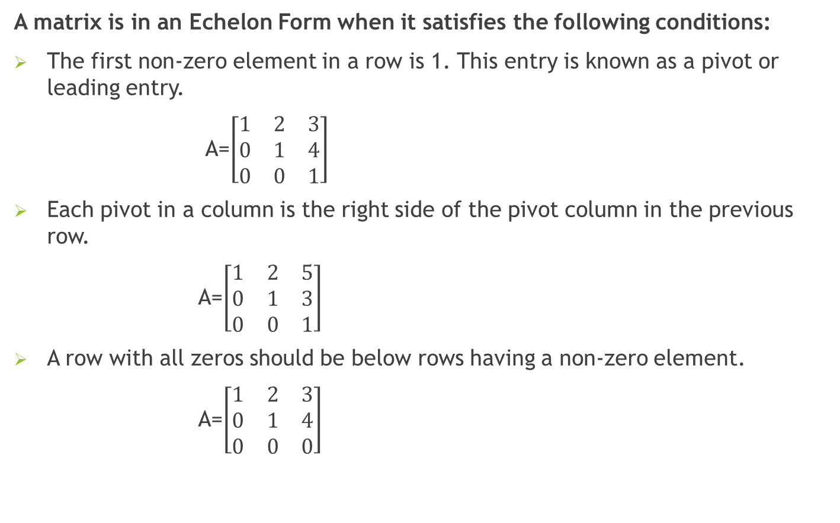
Echelon matrix
A matrix is in an Echelon Form when it satisfies the following conditions:
The first non-zero element in a row is 1. This entry is known as a pivot or leading entry.
A=$\left[\begin{matrix}1 & 2 & 3 \\ 0 & 1 & 4 \\ 0 & 0 & 1\end{matrix}\right]$
Each pivot in a column is the right side of the pivot column in the previous row.
A=$\left[\begin{matrix}1 & 2 & 5 \\ 0 & 1 & 3 \\ 0 & 0 & 1\end{matrix}\right]$
A row with all zeros should be below rows having a non-zero element.
A=$\left[\begin{matrix}1 & 2 & 3 \\ 0 & 1 & 4 \\ 0 & 0 & 0\end{matrix}\right]$

Slide 5
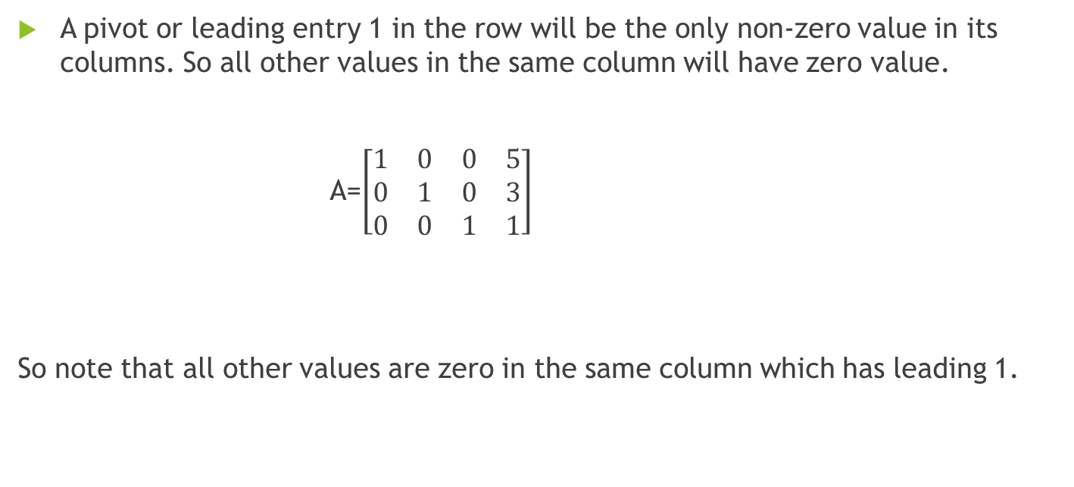
Reduced Echelon Matrix
A pivot or leading entry 1 in the row will be the only non-zero value in its columns. So all other values in the same column will have zero value.
A=$\left[\begin{matrix}1 & 0 & 0 & 5 \\ 0 & 1 & 0 & 3 \\ 0 & 0 & 1 & 1\end{matrix}\right]$
So note that all other values are zero in the same column which has leading 1.

Slide 6
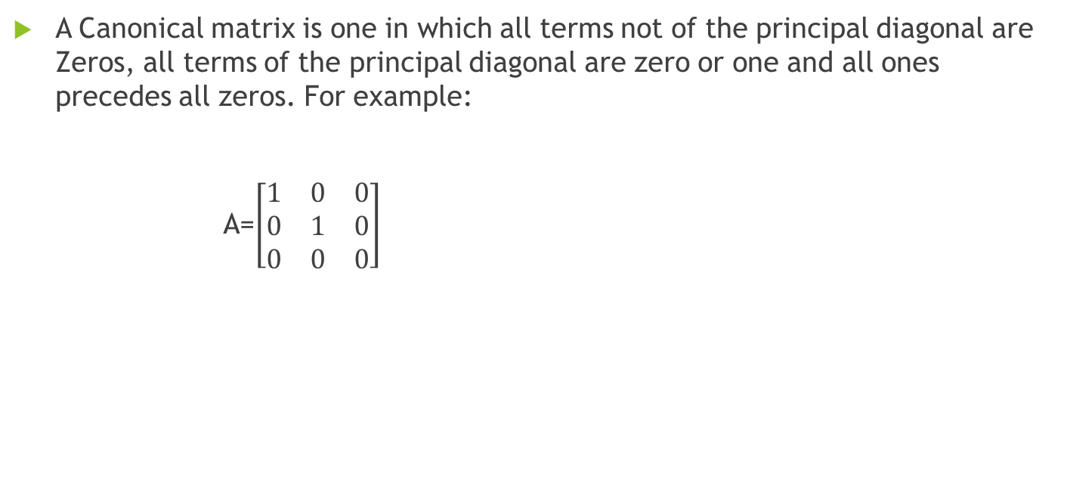
Canonical matrix
A Canonical matrix is one in which all terms not of the principal diagonal are Zeros, all terms of the principal diagonal are zero or one and all ones precedes all zeros. For example:
A=$\left[\begin{matrix}1 & 0 & 0 \\ 0 & 1 & 0 \\ 0 & 0 & 0\end{matrix}\right]$

Slide 7
Rank of Matrix
Rank of matrix is defined as the order of the largest square sub-matrix whose determinant is not Zero.
In another ways, Rank of matrix is defined by the number of non zero rows in echelon form.

Slide 8
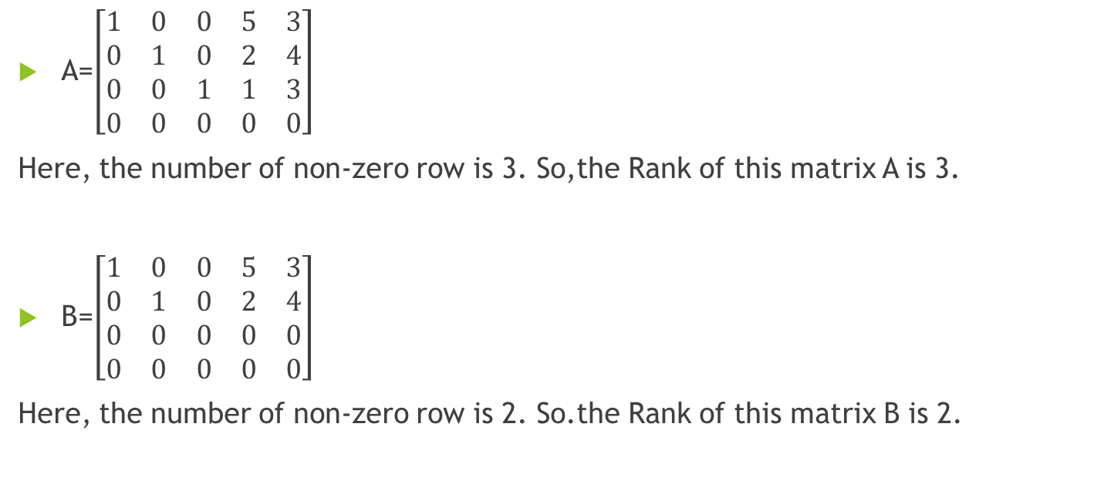
Example of Rank matrix in Echelon form
A=$\left[\begin{matrix}1 & 0 & 0 & 5 & 3 \\ 0 & 1 & 0 & 2 & 4 \\ 0 & 0 & 1 & 1 & 3 \\ 0 & 0 & 0 & 0 & 0\end{matrix}\right]$
Here, the number of non-zero row is 3. So,the Rank of this matrix A is 3.
B=$\left[\begin{matrix}1 & 0 & 0 & 5 & 3 \\ 0 & 1 & 0 & 2 & 4 \\ 0 & 0 & 0 & 0 & 0 \\ 0 & 0 & 0 & 0 & 0\end{matrix}\right]$
Here, the number of non-zero row is 2. So.the Rank of this matrix B is 2.

Slide 9
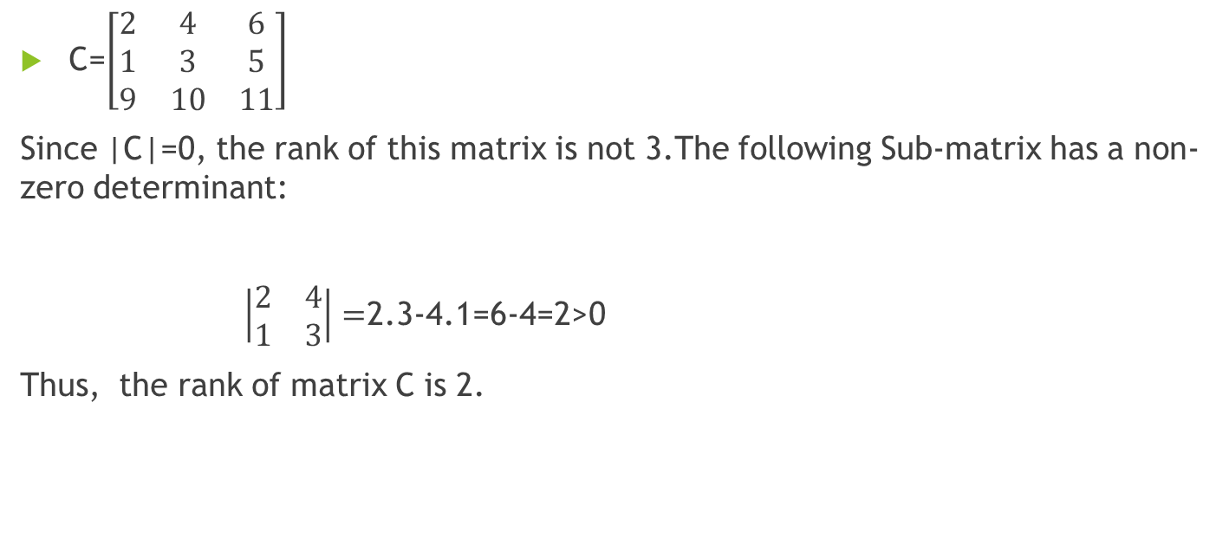
Example of Rank matrix in Determinant form
C=$\left[\begin{matrix}2 & 4 & 6 \\ 1 & 3 & 5 \\ 9 & 10 & 11\end{matrix}\right]$
Since |C|=0, the rank of this matrix is not 3.The following Sub-matrix has a non-zero determinant:
$\left|\begin{matrix}2 & 4 \\ 1 & 3\end{matrix}\right|=$2.3-4.1=6-4=2>0
Thus, the rank of matrix C is 2.

Slide 10
THANKS
for listening me

